Slide 1
Modeling of an ARCh TOP Guitar
Nate Sherwood
Chris Standley

Slide 2
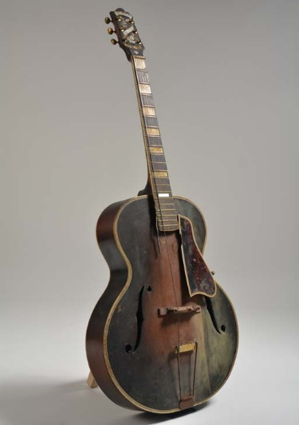
Project Definition
Reverse engineer surfaces of a 1932 Epiphone DE LUXE
Create models of the top ,back ,and neck
Repair damage on guitar
Preserve history of these guitars
Develop a process for working with 3D scanned meshes

Slide 3
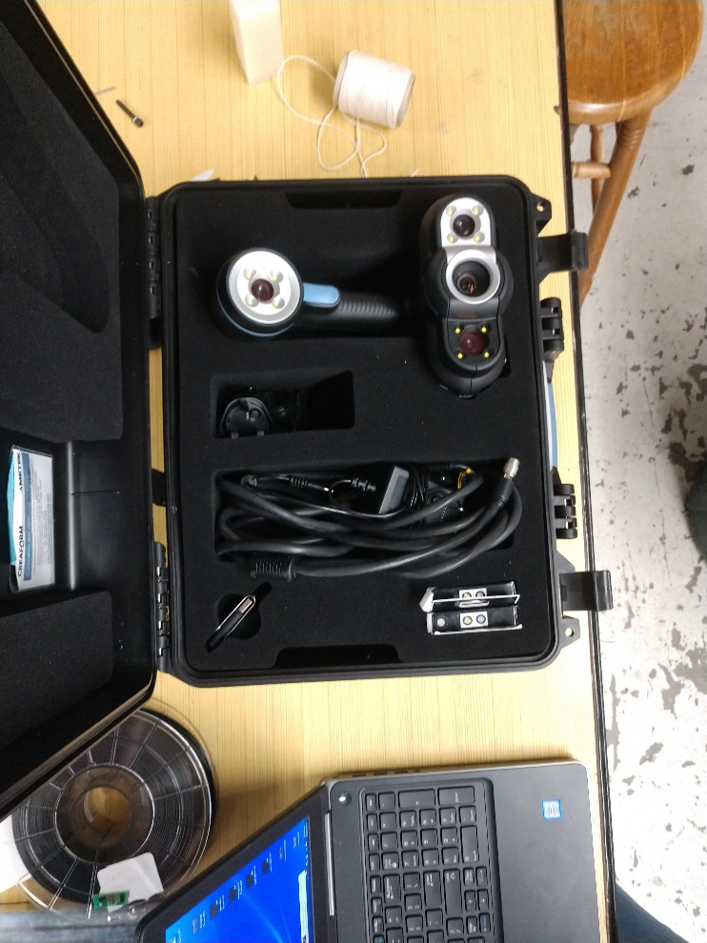
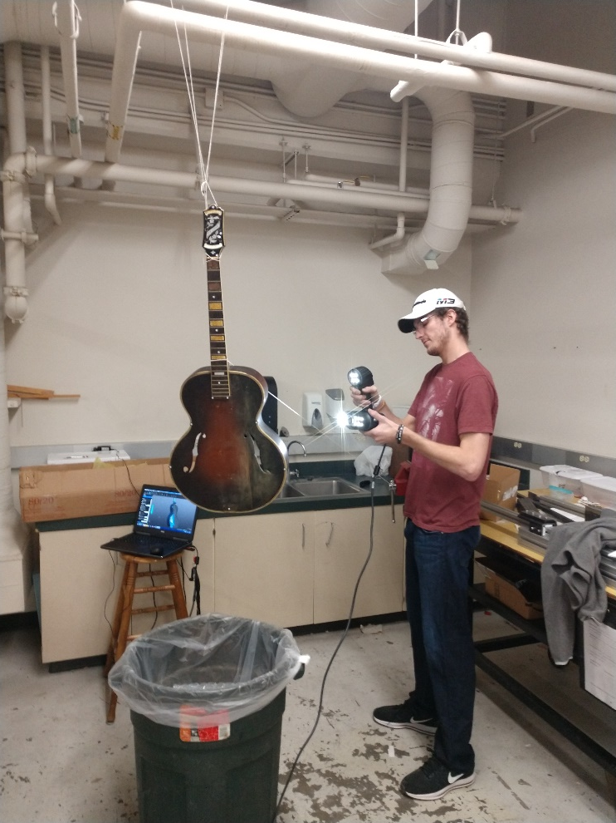
3D Scanning
Suspending the guitar
Hold guitar as still as possible while scanning
Place positioning sticker on shiny / curved surfaces
Very Important to Scan all angles- if possible
Learn VX Elements

Slide 4
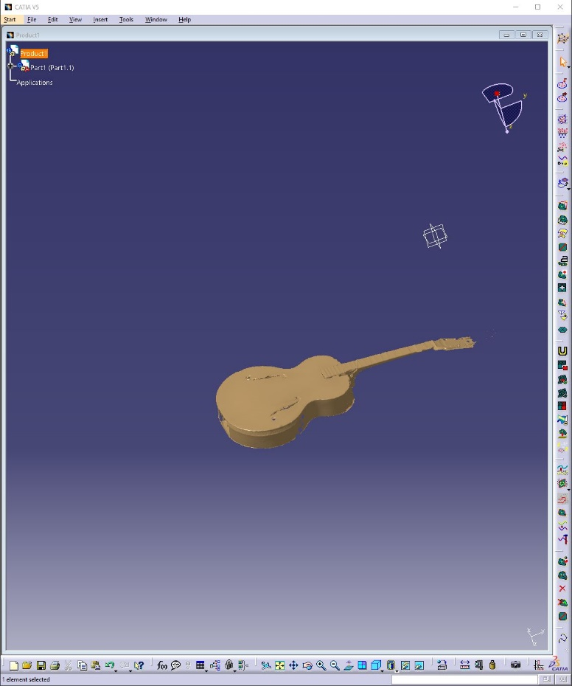
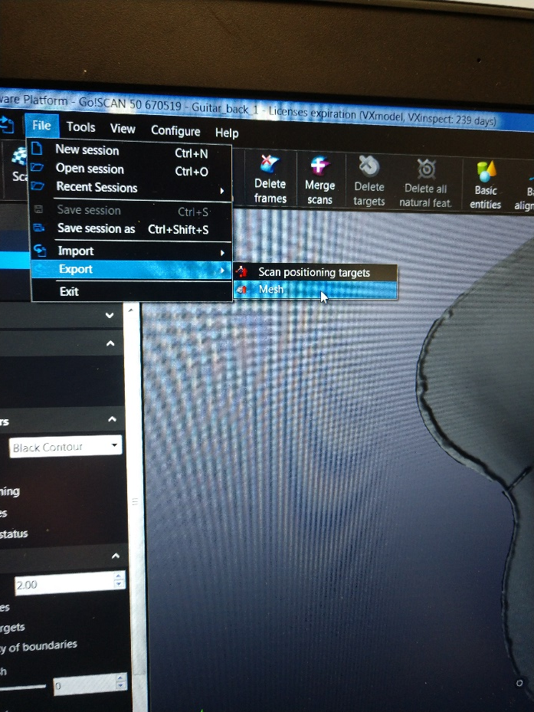
Export Meshes/ Surfacing with Meshes
Export 3D Scan file as an STL
Use the Digitized Shape Editor Work Bench

Slide 5
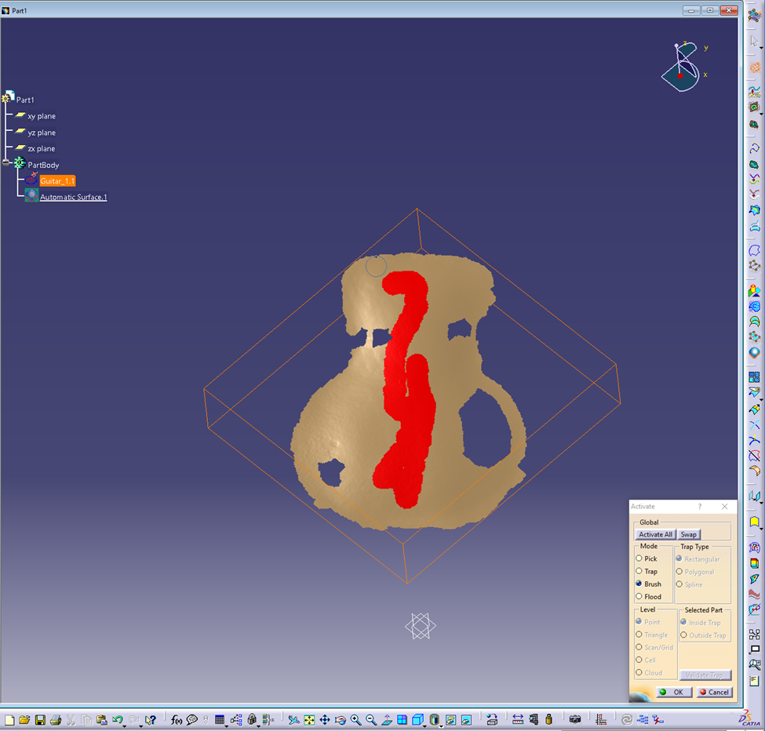
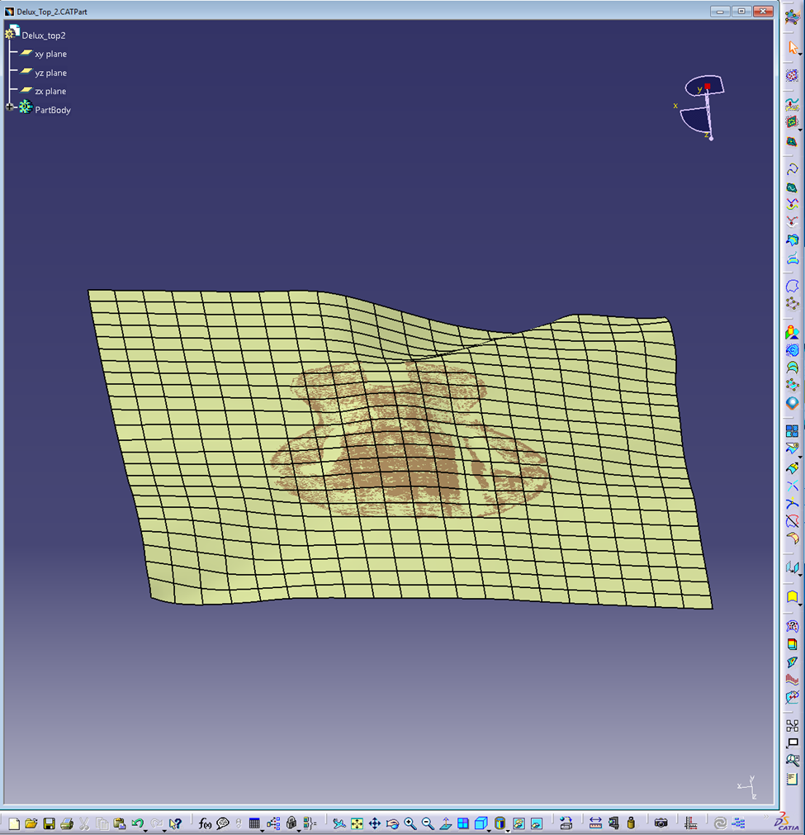
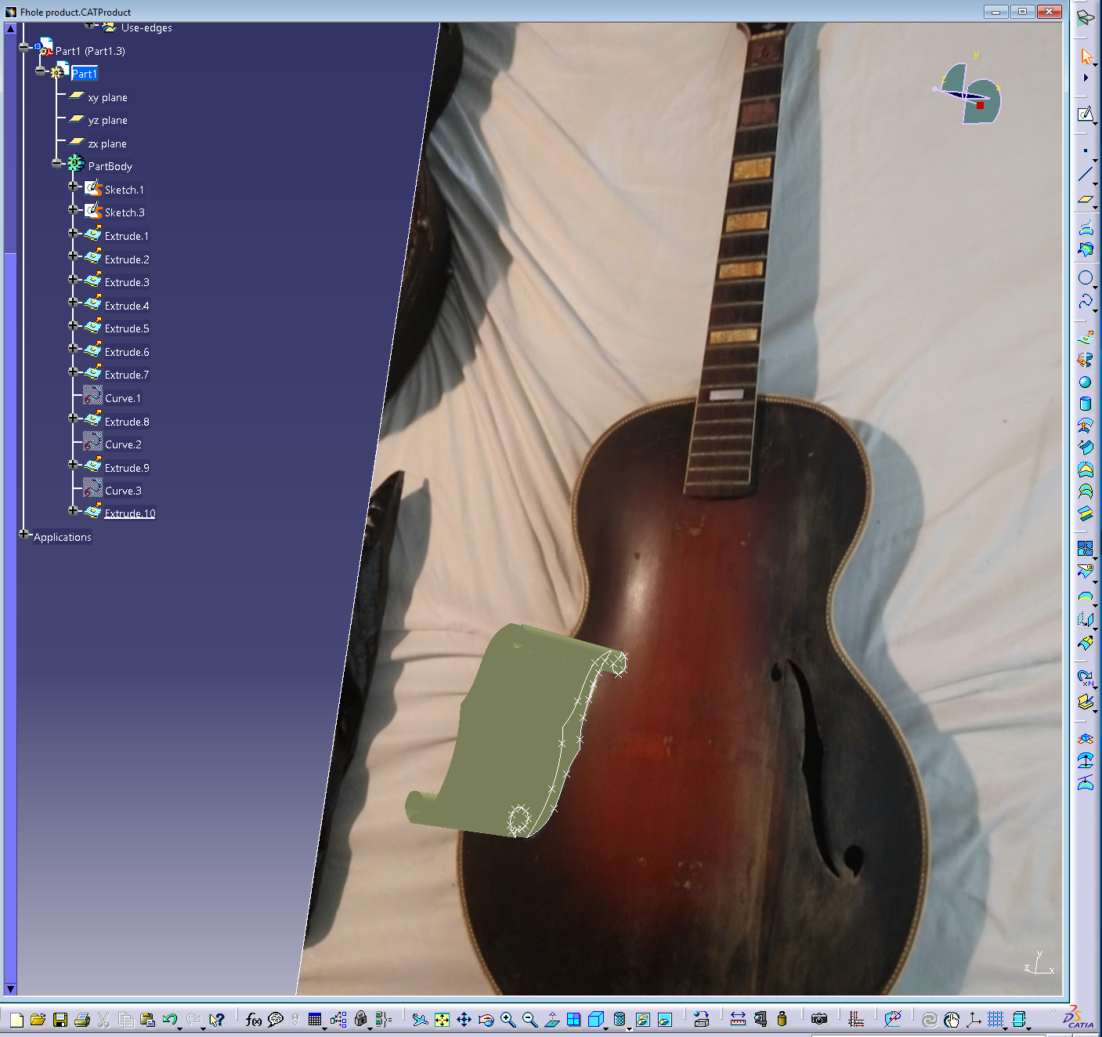
Techniques
Quick Surface Reconstruction Work Bench
Activate Tool, Select Brush and, paint surface leaving out any unwanted imperfections
Quick Surface Reconstruction Workbench.
Select Automatic Surface tool. In the dialog box select: Full internal tangency, Fill holes, Extended Surfaces
Make sure all activated mesh points are connected or the automatic surface tool will not work
Sketcher Workbench
Sketch fine details
Extrude sketch into a surface as a cutting element.

Slide 6
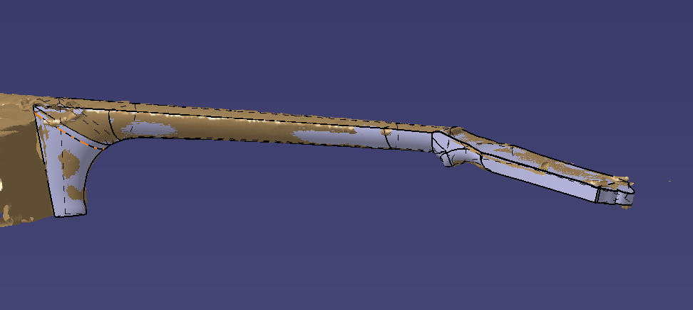
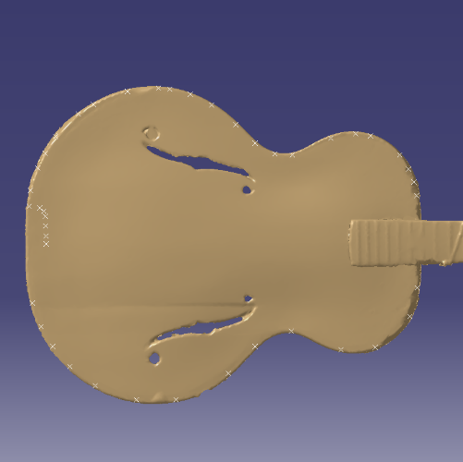
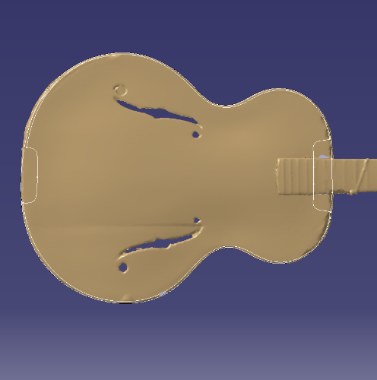
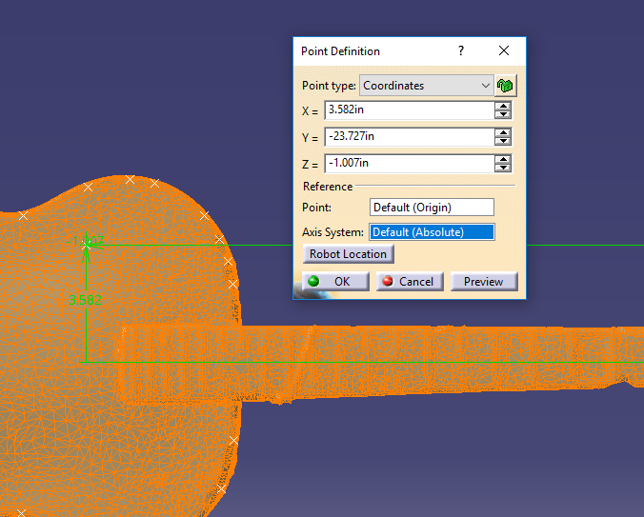
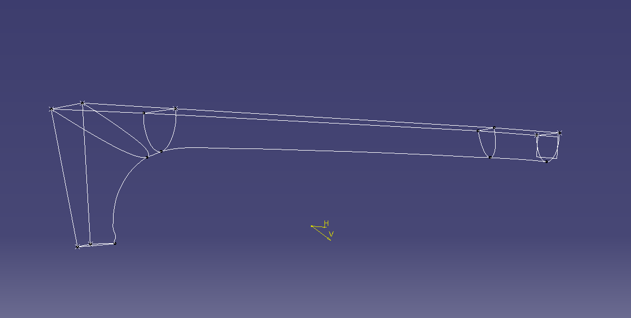
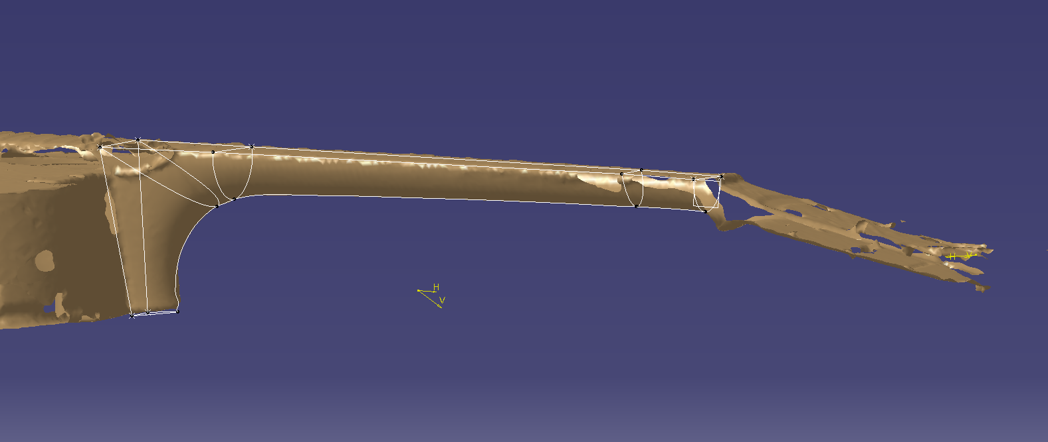
Techniques Cont.
Generative shape design workbench
Place points on the cloud- create spline form those points- 3D project splines to desired plane.
To create surfaces the ‘multi-section surface’ tool in generative shape design workbench is helpful.

Slide 7
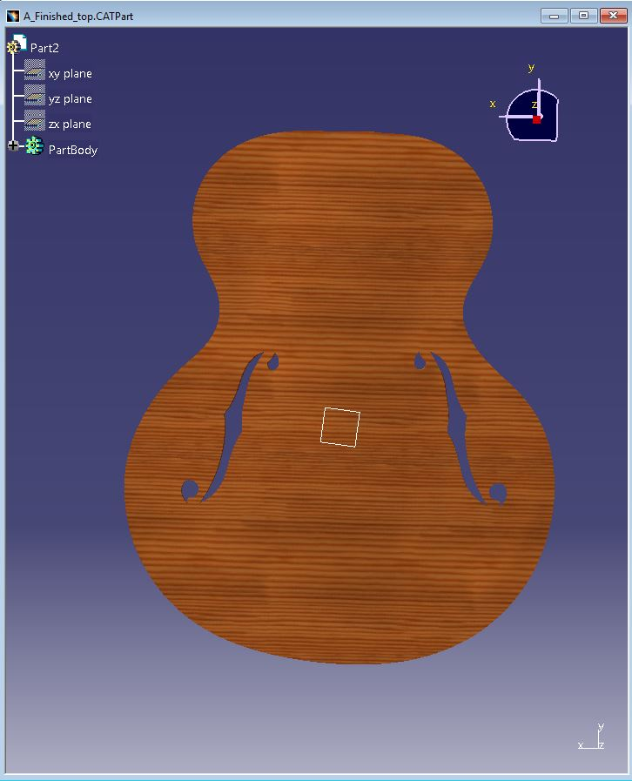
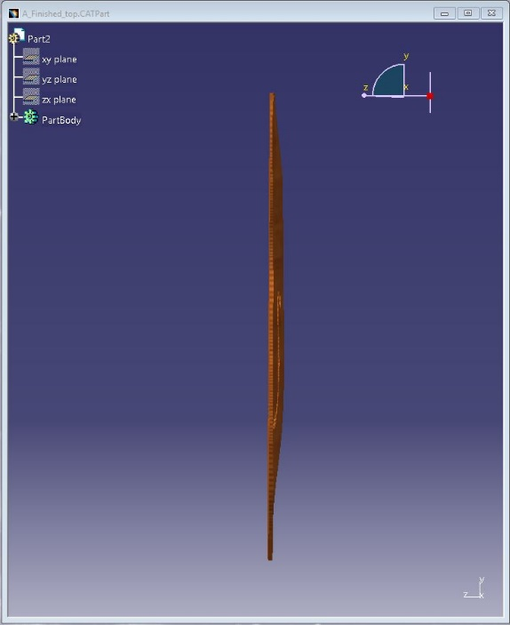
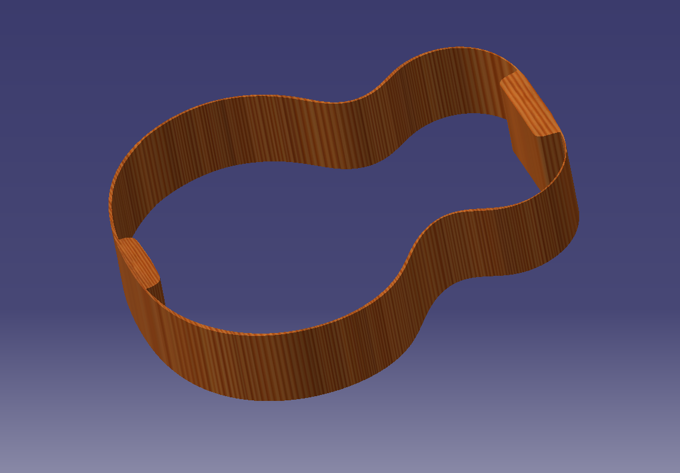
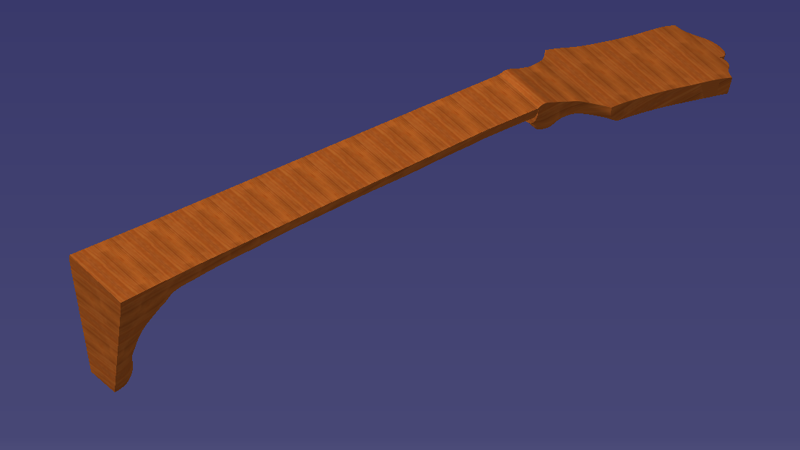
Finished Parts

Slide 8
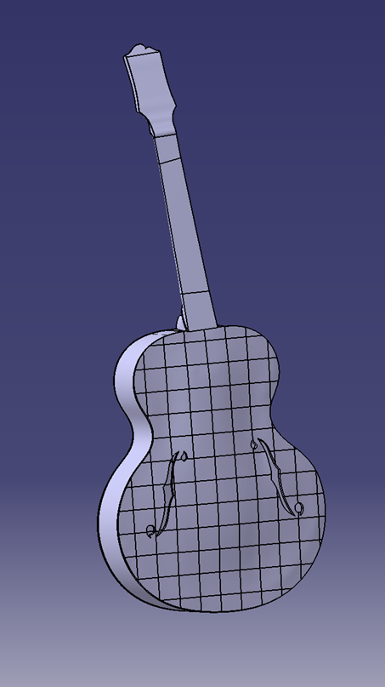
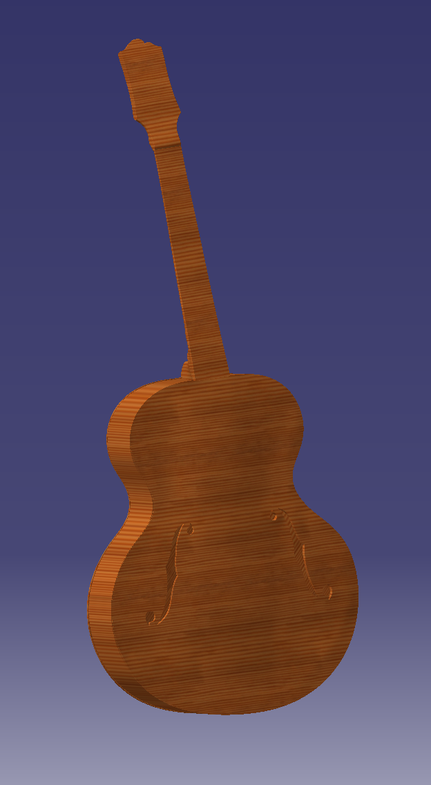
Final Assembly

